Slide 1

DEPARTMENT OF ELECTRONICS AND COMMUNICATION
MACHINE LEARNING PROJECT
PRODUCT RECOMMENDATION SYSTEM.
SL.NO | NAME | USN | ROLL NO.
1 | NANDEESH KATKOL | 02FE22BEC040 | 40
2 | PRIYANSHU PORWAL | 02FE22BEC056 | 54
3 | PRIYANKA BUDIHAL | 02FE22BEC054 | 52
4 | JAMUNA PULPATLI | 02FE23BEC032 | 32
Under the Guidance of
Dr. Dattaprasad A. Torse

Slide 2
CONTENTS
Sl.no | TITLE
1 | INTRODUCTION
2 | MOTIVATION & BACKGROUND
3 | LITERATURE SURVEY
4 | OBJECTIVES
5 | METODOLOGY
6 | WORK FLOW
7 | RESULTS
8 | REFERENCES
13-01-2025
Dept. of ECE
2

Slide 3
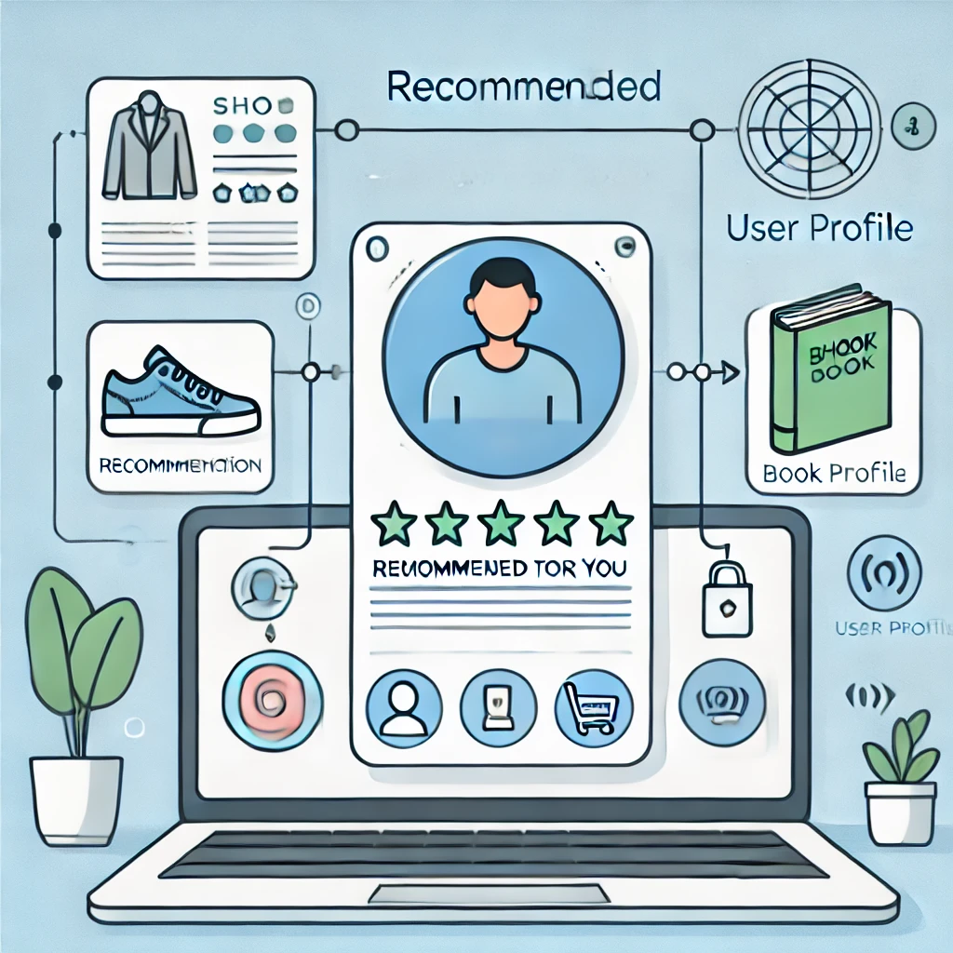
INTRODUCTION
The overwhelming number of available products makes it challenging for user to choose the right one.
Product recommendation systems simplify the selection process by aligning suggestions with individual preferences.
Act as tools to assess user behavior, preferences, and past actions to generate personalized suggestions.
Users provide feedback to continuously refine and enhance the accuracy of recommendations.
Commonly used in e-commerce, streaming platforms (e.g., Netflix), and social media (e.g., Facebook, LinkedIn).

Slide 4
MOTIVATION
In today's digital age, consumers face an overwhelming amount of choices, leading to decision fatigue. A recommendation system directly addresses this by simplifying the selection process and enhancing user satisfaction.
This project enables hands-on experience with advanced methodologies such as collaborative filtering, hybrid models, and deep learning, which are highly sought-after in tech roles.
The aim is to create a system that personalizes recommendations while encouraging users to explore new brands, categories, and innovative products.
Enhance user engagement through feedback-driven learning, creating a dynamic and intuitive shopping experience.

Slide 5
Background
Information Overload : Consumers face an overwhelming number of product choices across categories, making decision-making challenging.
Traditional Methods : Early recommendation systems relied on generic popular product lists, offering limited personalization and relevance.
Rise of E-commerce : The growth of online shopping platforms has created a demand for personalized shopping experiences to cater to a diverse audience.
Limitations of Early Systems: Early recommendation models lacked the ability to adapt to changing user preferences and struggled with sparse data, especially for new users or products.

Slide 6
LITERATURE REVIEW
Paper Title | Methodology/Implementation | Data set Description | Performance Parameter | Limitations/Disadvantanges | Gaps Identified
Design and Implementation of a Product Recommendation System with Association and Clustering Algorithms | Combines Apriori Algorithm for product associations and K-Means Clustering for grouping customer demographics using transactional sales and customer data. | Tested on data from an Austrian B2B hygiene retailer with >500 products, using sales and demographic data (e.g., location, customer type, order type). | Evaluated by support, confidence, lift for association rules and cluster quality (>30% sample size per cluster). | Limited to one case study, lacks real-world implementation, and uses minimal demographic attributes. | Needs scalability, broader industry testing, and advanced demographic data for improved clustering and generalizability.
Comparative Study of Machine Learning Approaches for Amazon Reviews | Compared SVM, Naive Bayes, and Maximum Entropy classifiers using unigrams and weighted unigrams for sentiment classification of Amazon reviews. | Used 21,500 reviews (9,500 positive, 9,500 negative, 2,500 neutral) for training and 3,000 for testing, collected via the Amazon API. | SVM achieved the highest accuracy (81.20%) using weighted unigrams, outperforming Naive Bayes (77.42%) and Maximum Entropy (70.35%). | Small dataset and exclusion of emoticons limited model performance and adaptability. | Lack of multilingual analysis, advanced features like deep learning, and hybrid classifier techniques.
Optimizing Recommender Systems Using Markov Decision Processes: A Sequential Decision Framework for E-Commerce | MDP-based recommender system optimized for sequential decisions using Markov chain initialization to balance immediate and long-term rewards. | Used real-world data from an online bookstore with over 10,000 user transactions and 100+ items, filtered for reliability. | Measured by user acceptance rates, commercial value, and accuracy metrics like Exponential Decay and Recommendation Score. | Limited by assumptions of recommendation independence and lack of contextual user attributes or multimedia data. | Misses hybrid techniques, deeper user context, and requires frequent updates to match evolving behaviors.

Slide 7
Paper Title | Methodology/Implementation | Data set Description | Performance Parameter | Limitations/Disadvtanges | Gaps Identified
Development of Product Recommendation Systems Using Popularity-Based and Collaborative Filtering Approaches | Developed two types of recommendation systems: a popularity-based system recommending top-rated books and a collaborative filtering system using cosine similarity to suggest similar books based on user ratings. | Utilized datasets containing book, user, and rating data, filtered to include only well-read users (rated more than 200 books) and popular books (rated more than 50 times). | Evaluated based on the relevance of recommendations, accuracy of similarity computation (cosine similarity), and the ability to cater to user preferences effectively. | Suffers from the cold start problem for new users or items, challenges in maintaining diversity in recommendations, and scalability issues with growing data. | Lacks integration of deep learning or hybrid approaches and does not address privacy concerns with user data comprehensively.
The Use of Machine Learning Algorithms in Recommender Systems: A Systematic Review | Conducted a systematic review of 26 peer-reviewed studies on ML algorithms in recommender systems, focusing on implemented and tested approaches using real or simulated data. | Predominantly used datasets: MovieLens and IMDb for movies, and text-based datasets for documents and product reviews. | Emphasized algorithm simplicity, computational efficiency, scalability, and testing accuracy; Bayesian and Decision Tree algorithms were most popular due to ease of implementation. | Limited focus on early lifecycle stages (requirements, design) and maintenance; challenges with complex algorithms like Neural Networks due to interpretability issues. | Lack of standardized ML algorithm classification and insufficient research in underexplored application domains and software engineering stages like design and maintenance.
Advanced techniques for better Recommendations | Employs collaborative filtering (user behavior) and content-based filtering (item characteristics), with hybrid systems combining both for enhanced accuracy. | Requires substantial user interaction data (e.g., preferences or purchase history) for effective collaborative filtering. | Achieves high accuracy and personalization; hybrid systems boost user experience and sales | Cold-start problem remains a challenge for new users or items due to insufficient data. | Further work needed to address the cold-start problem and improve hybrid system performance in sparse data environments.

Slide 8
OBJECTIVES
Design an efficient recommendation system that delivers personalized suggestions.
Utilize advanced algorithms like SVM and KNN for better proximity detection and classification.
Ensure real-time recommendations by incorporating product availability and user preferences.
Evaluate the system's performance using metrics like precision, recall, and F1-score.
Develop a scalable system capable of handling large datasets efficiently.

Slide 9
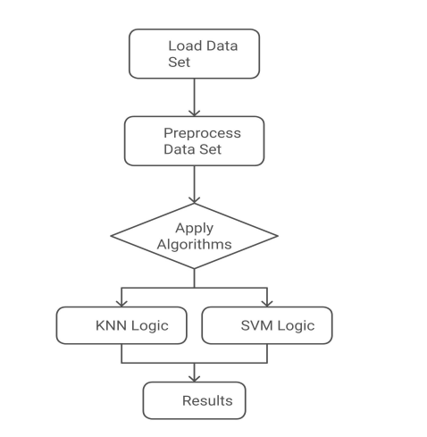
METHODOLOGY
Explain with a block diagram

Slide 10
WORK FLOW
Data Collection
Gather user data: reading history, ratings, and reviews.
Collect book metadata: genres, authors, themes, etc.
Data Preprocessing
Clean and structure data for consistency.
Recommendation Engine
Collaborative Filtering: Recommends based on similar user preferences.
Content-Based Filtering: Suggests books based on similar attributes.
Hybrid Model: Combines both approaches for accuracy.

Slide 11
RESULTS
Our recommended recommendation system boasts high effectiveness in Precision of 86.7%, Recall of 83.2%, and F1 Score of 84.9%. This means the system is relevantly accurate for giving product recommendations and is thus a good balance between precision and recall. Figure 3 depicts the developed web application user interface in which the system presents real-time product recommendations. It is a well-streamlined design to assure that the interface allows for smooth and intuitive interaction as well as efficient navigation.

Slide 12
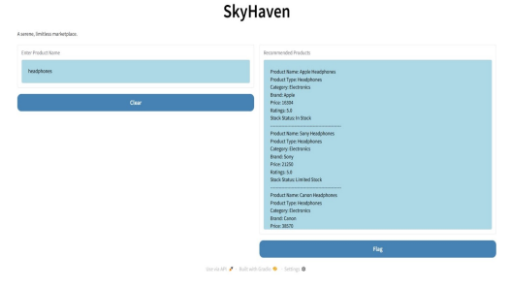
RESULTS

Slide 13
REFERENCES
[1] Shani et al., “The focus is on MDP-based recommender systems.” A possible video could be a tutorial on implementing an MDP-based recommendation system for e-commerce
[2] From ML02.pdf, “The focus is on clustering and association algorithms for recommendations.” You could create a video demonstrating association rule mining with practical examples in retail.
[3] From Amazon Reviews Study, “It is based on sentiment analysis.” A video idea can be a step-by-step guide on how to do sentiment analysis using unigrams and machine learning models such as SVM.
[4] Amazon Products Sales Dataset 2023, “Dataset available on Kaggle.”
[5] D. Burch and G. Lawrence, “Supermarket Own Brands, Supply Chains and the Transformation of the Agri-food System,” 2005, doi: 10.48416/IJSAF.V13I1.312.
[6] S. H. Choi, S. Kang, and Y. J. Jeon, “Personalized recommendation system based on product specification values,” Expert systems with applications, vol. 31, no. 3, pp. 607–616, 2006, doi: 10.1016/j.eswa.2005.09.074.

